Slide 1

WHERE IN tORONTO
SrivaIshnavi Korukanti

Slide 2
CONTENTS
Introduction
Data
Methodology
Results
Discussion
Conclusion

Slide 3
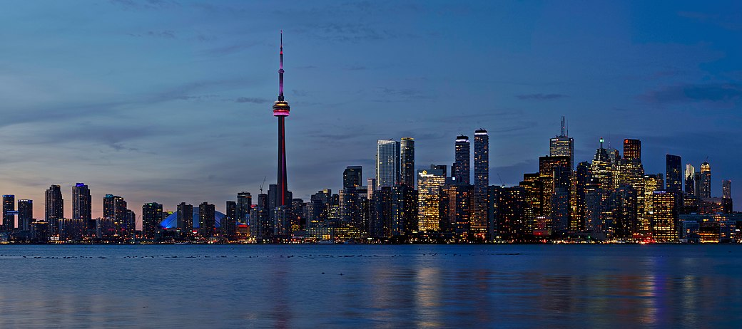
TORONTO

Slide 4
What are the good hotels to stay in downtown Toronto ?
Which neighbourhoods in downtown Toronto would be ideal to build a hotel?

Slide 5
DATA
Scrapping the data using Beautiful Soup Python package
Using Foursquare API to get the venue information and ratings
Data cleaning

Slide 6
Methodology
Neighborhoods in downtown Toronto
Ratings of hotels in downtown Toronto

Slide 7
RESULTS
Financial district neighbourhood has the largest number of Hotels
Underground city
Garden district area hotels ratings are not available
Harbourfront area does not have many hotels

Slide 8
DISCUSSION
Financial district is the best place to stay in Toronto
Staying close by Union station has quick access to all parts of the city
Garden district has century-old buildings
Harbourfront area is close to lake Ontario

Slide 9
CONCLUSION
University of Toronto surroundings as it one of the most reputed universities in the world and lot of people visit for academic purposes
Harbourfront area as this area is close to Toronto islands and can make choice of many tourists and can provide views of Lake Ontario

